Slide 1
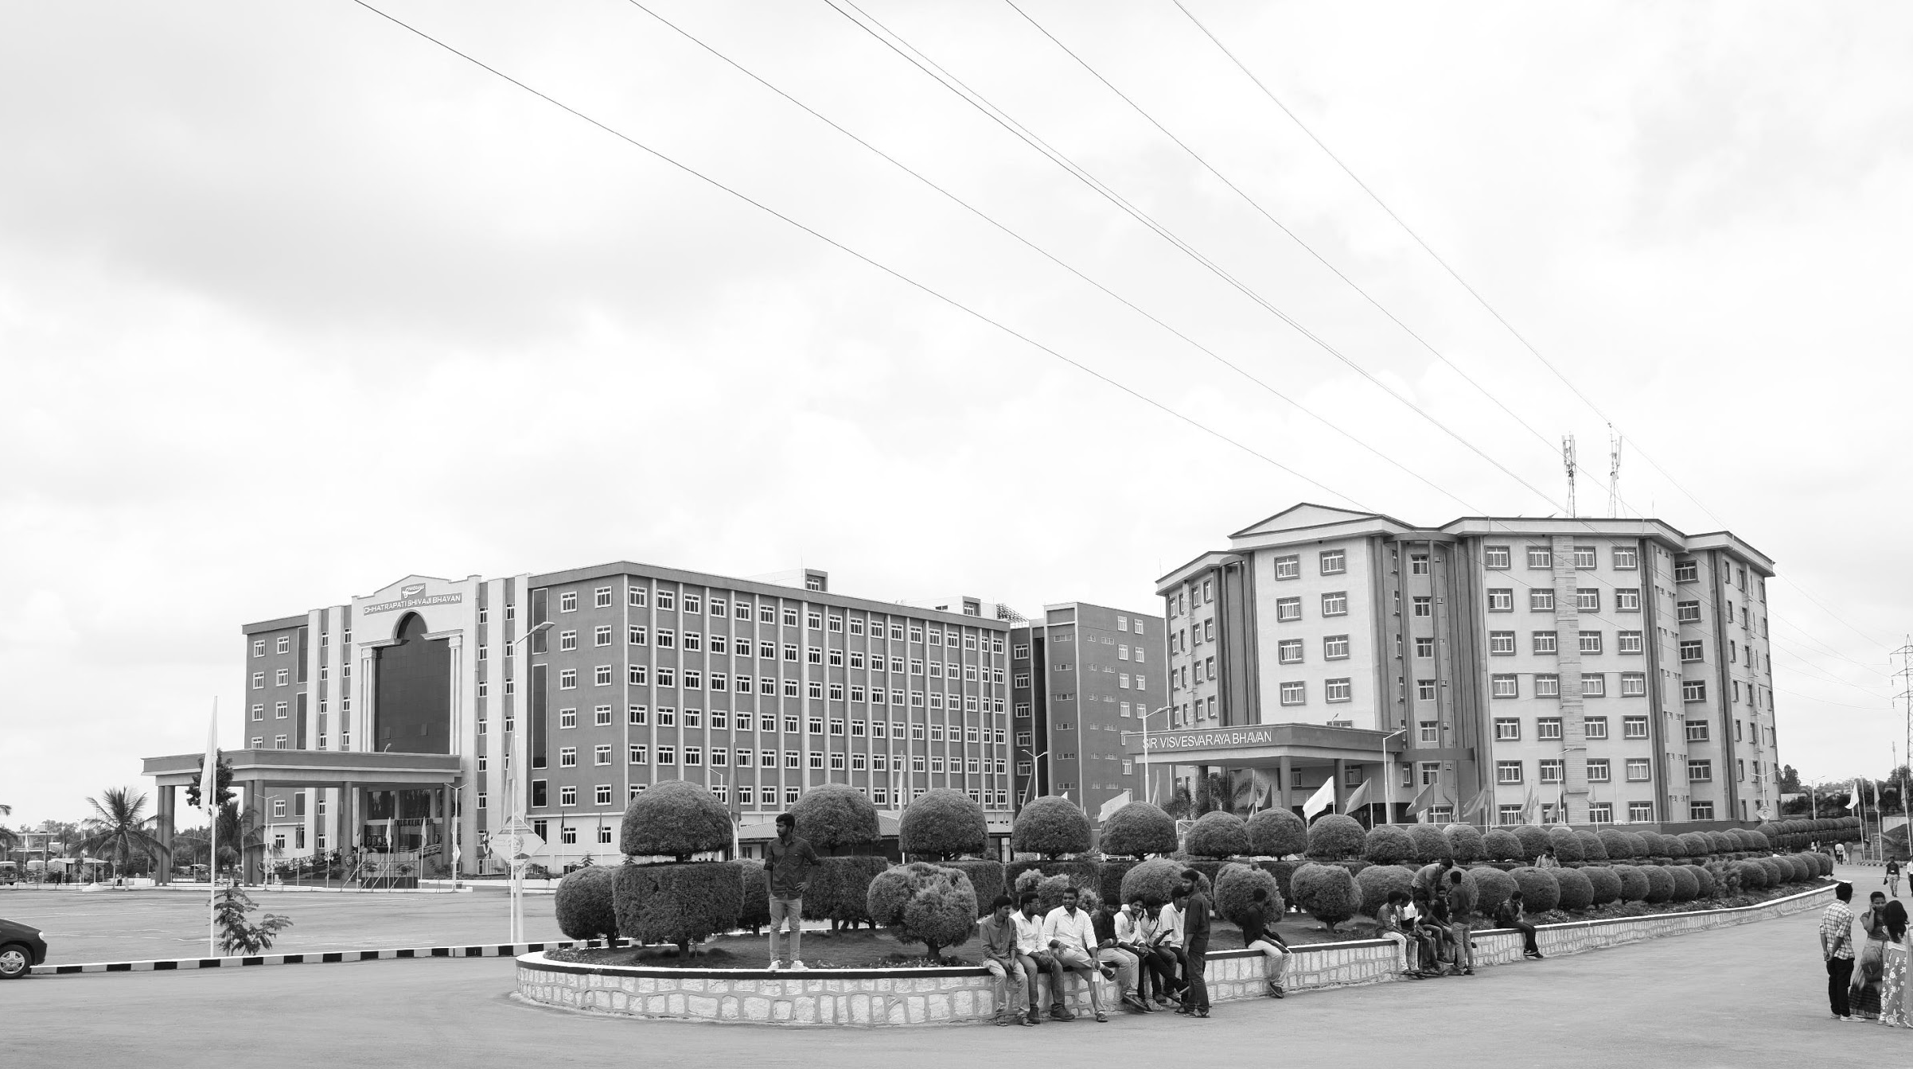

VISUAL SLAM BASED AUTONOMOUS ROBOT
AY 2021-25
GITAM UNIVERSITY
Major Project
Project ID: A6
A University should be a place of light, of liberty, and of learning.
Department of Electrical Electronics and Communication Engineering
Project Team:
M.DIWAKAR REDDY - BU21EECE0100601
G.MAHESH REDDY – BU21EECE0100531
D.VINAY KUMAR – BU21EECE0100452
Project Mentor:
H.J JAYATHEERTHA
www.gitamedu.com

Slide 2




Project Group – Details
Photo
Track
Roll No
Name
EECE AI/ML
BU21EECE0100601
M.DIWAKAR REDDY
EECE AI/ML
BU21EECE0100531
G,MAHESH REDDY
EECE AI/ML
BU21EECE0100452
D.VINAY KUMAR

Slide 3
Objective and Goals
Objective
The objective of the Visual SLAM-based autonomous robot project is to develop a system that allows the robot to navigate and map its environment autonomously using visual inputs from cameras. This involves integrating advanced computer vision techniques to detect and track features, estimate the robot's position, and continuously update a detailed map of the surroundings. The goal is to achieve accurate, real-time localization and mapping, enabling the robot to operate efficiently in dynamic and unstructured environments without human intervention.
Goals
Main Goals
Real-Time Navigation: Enable the robot to autonomously navigate through its environment using visual data, avoiding obstacles and following predefined paths.
Accurate Localization: Ensure precise estimation of the robot’s position and orientation within the environment based on visual inputs.
Map Creation and Updating: Develop and continuously update a detailed map of the environment, capturing both static and dynamic features.
Additional Goals
Integration with Other Sensors: Incorporate additional sensors, like IMUs or LiDAR, to enhance accuracy and provide redundancy.
User Interface and Visualization: Create tools for visualizing the robot’s path and the generated map, facilitating user interaction and analysis.

Slide 4
Project Plan
Research and Planning | 3 weeks
System Design | 6 weeks
Development and Prototyping | 8 weeks
Testing and Validation | 5 weeks
Deployment and Documentation | 2 weeks

Slide 5
Literature Survey
NAME | PUBLISHED DATE | AUTHOR NAME | ABSTRACT
A Review on Visual-SLAM: Advancements from Geometric Modelling to Learning-Based Semantic Scene Understanding Using Multi-Modal Sensor Fusion | 25 September 2022 | Tin Lai | Simultaneous Localisation and Mapping (SLAM) is one of the fundamental problems in autonomous mobile robots where a robot needs to reconstruct a previously unseen environment while simultaneously localising itself with respect to the map. In particular, Visual-SLAM uses various sensors from the mobile robot for collecting and sensing a representation of the map. Traditionally, geometric model-based techniques were used to tackle the SLAM problem, which tends to be error-prone under challenging environments.
vSLAM: vision-based SLAM for autonomous vehicle navigation | 2 September 2004 | Niklas Karlsson, Jim Ostrowski, Enrico Di Bernardo, Paolo Pirjanian | Among the numerous challenges of building autonomous/unmanned vehicles is that of reliable and autonomous localization in an unknown environment. In this paper we present a system that can efficiently and autonomously solve the robotics 'SLAM' problem, where a robot placed in an unknown environment, simultaneously must localize itself and make a map of the environment. The system is vision-based, and makes use of Evolution Robotic's powerful object recognition technology. As the robot explores the environment, it is continuously performing four tasks, using information from acquired images and the drive system odometry.
GITHUB
https://github.com/joshnewans/articubot_one/tree/adb08202d3dafeeaf8a3691ddd64aa8551c40f78
https://github.com/aliasghar53/autonomous-robot

Slide 6
Analysis - SWOT
Strengths
Weaknesses
W1. Sensitivity to Environmental Conditions
W2. Computational Demands
S1. Enhanced Navigation Capabilities
S2. Detailed Environmental Mapping
S3. Real-Time Operation
Threats
T1. Technological Advancements
T2. Security Vulnerabilities
Opportunities
O1.Technological Innovation
O2.Consumer robotics
O3. Agriculture robots

Slide 7
Analysis – 4W1H
Why: To develop a robot that can autonomously navigate and map its surroundings using vision-based SLAM (Simultaneous Localization and Mapping) techniques. This technology has applications in various fields such as autonomous driving, robotics, and industrial automation.
What: Build an autonomous robot that uses vSLAM for real-time navigation and mapping without relying on GPS or external sensors. The robot will be capable of navigating in dynamic and unstructured environments.
Where: The robot will be deployed in environments where traditional navigation methods (like GPS) are unreliable or unavailable, such as indoor spaces, warehouses, or complex outdoor terrains.
When: The project will progress over a period of 5-6 months, with different phases including research, design, development, and testing.
How: The project will use a combination of vision-based sensors (cameras), computing hardware, and software algorithms for vSLAM. The development will involve implementing a vSLAM algorithm, integrating it with hardware, testing in both simulation and real-world environments, and optimizing for performance and reliability.
Refined Objective: To create an efficient, reliable, and adaptable autonomous robot that can perform navigation and mapping tasks using vision-based SLAM in various real-world environments, enhancing the robot's ability to operate autonomously in challenging conditions.

Slide 8
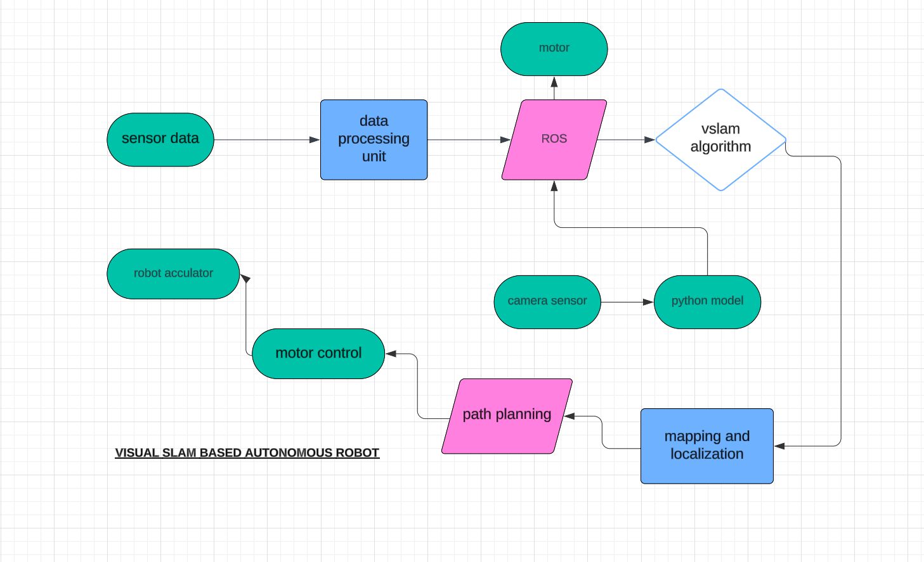
Architecture

Slide 9
Use Cases & Testing
Use Cases
Xx
Xx
X
X
Test Cases
XX
XX
XX

Slide 10
Implementation and Results – Iteration 1
Iteration 1 : Results

Slide 11
Implementation and Results – Iteration 2
Iteration : Results + Validation against the usecases and test cases

Slide 12
Contribution
Team Progress and Movement
learning about new softwares and understanding how the components actually work
Facing new challenges and overcoming those challenges
PREPARING DETAILED DOCUMENTATION AND REPORTING FOR THE PROJECT.
COLLABORATION WITH MENTORS AND EXPERTS TO GAIN INSIGHTS AND FEEDBACK.
WEEKLY TEAM MEETINGS TO DISCUSS PROGRESS, CHALLENGES, AND UPCOMING TASKS IMPLEMENT REAL-TIMEMONITORING AND SELF- HEALING CAPABILITIES
Individual Contribution
Key contributions: M.DIWAKAR REDDY
Hardware Setup
Research and Development
Key contributions: G.MAHESH REDDY
Analysis
Documentation
Key contributions: D.vinay kumar
Literature survey
External works

Slide 13
Conclusion & Future Work
Summary and Conclusion
The project integrates a camera module with a Raspberry Pi to process images and control a robot using OpenCV and ROS. It handles tasks like obstacle detection and navigation via motor control and sensor feedback. This setup enables real-time vision-based control for autonomous robot operation.
Future Work
Autonomous Navigation
Advanced Object Recognition
Battery Management Systems

Slide 14

THANK YOU

